Slide 1

effortless
Your gate to a healthy lifestyle

Slide 2
ELEVATOR PITCH
We are planning to establish an application that is specialized in making healthy meals.
The unique thing about our company is that it will Customized meals based on customers' need.
We see this project as important and successful as taking care of health has become a necessity, especially after the Corona pandemic.
it will achieve 30% profit during the first two years.

Slide 3
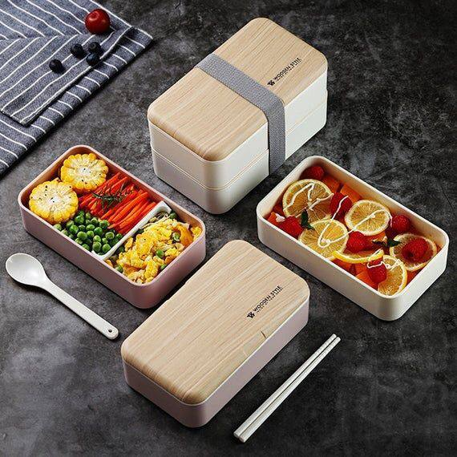
Key Activities
Healthy cooked meals
Shopping section for ingredients
Consultancy sessions with our nutritionist
Nutrition courses

Slide 4

Customer Segments
Class A
Youth from 25 to 40
Athletes
people who aim for a healthy lifestyle

Slide 5
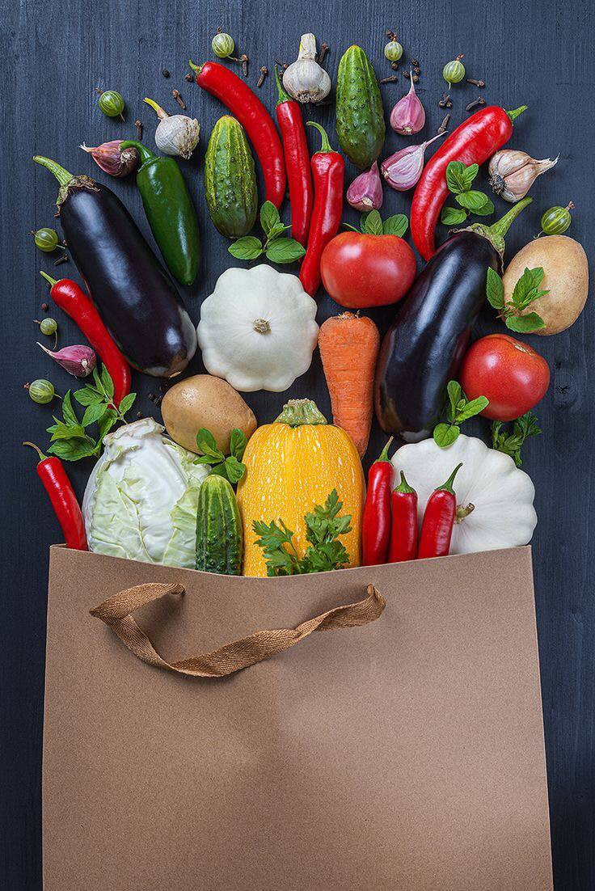

Value Proposition
Customized meals based on their need
Inclusive everything relevant to healthy lifestyle in-terms of nutrition
Pay cash or visa
Discount on monthly subscriptions

Slide 6
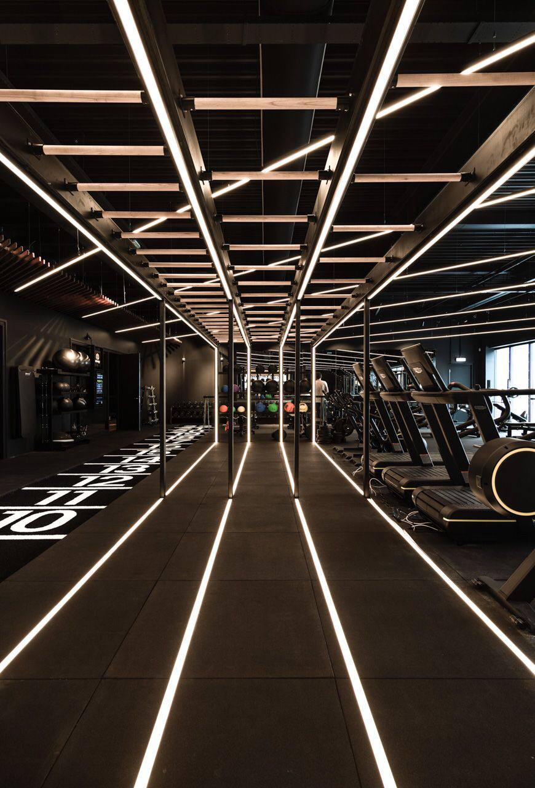
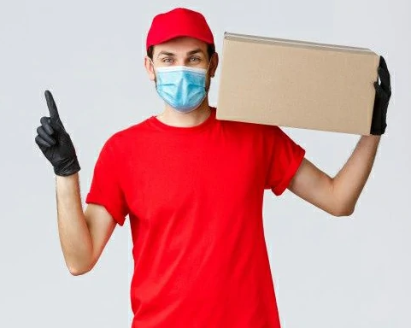
Channels
Application
Booths at the gyms
Athletic Events
Shipping companies

Slide 7

Customer Relationships
Social media
Contacts
Adjustment section
Offer & Discounts
Follow up

Slide 8
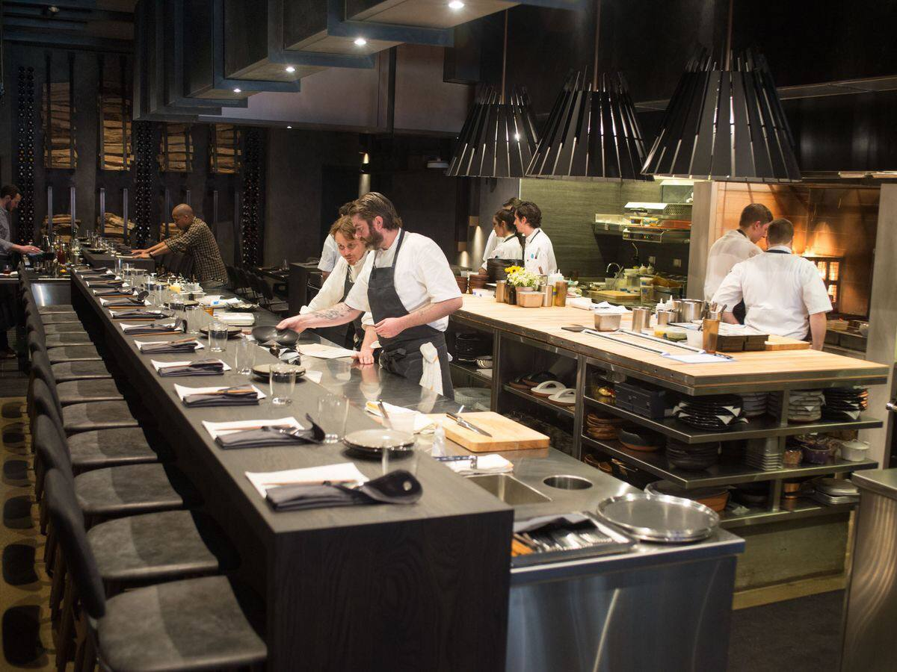
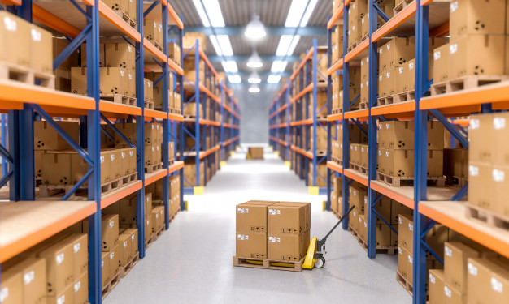
Key Resources
Ingredients )Suppliers)
Stockroom
Office
IT team
Kitchen
Nutrition specialists
chefs

Slide 9
Cost Structure
START-UP COSTS | COSTS
It | 24,000
Equipment | 12,000
TOTAL | 36,000
OPERATIONAL COSTS |  | COSTS | COSTS
FIXED | VARIABLE | MONTHLY | ANNUALLY
Salaries |  | 4,000 | 52,000
 | Ingredients | 15,000 | 180,000
Rentals |  | 8,500 | 102,000
 | Shipping | 2,500 | 30,000
Others |  | 3,000 | 36,000
TOTAL |  | 33,000 | 400,000

Slide 10

Key Partners
Gyms
Vodafone cash
Visa

Slide 11
Revenue Streams
YEARS | COSTS | REVENUE | NET PROFIT
1 | 436,000 | 502,000 | 66,000
2 | 433,750 | 630,000 | 196,250
TOTAL | 869,750 | 1132,000 | 262,250
Downloading app
Selling online
Monthly subscription
The partners

